Slide 1
Lecture 2
Radiation Integrals

Slide 2
Maxwell Equations and radiation
Solution of the radiation equation
Simplified solution at far field
Radiated power
Reciprocity

Slide 3
Maxwell Equations and Radiation

Slide 4
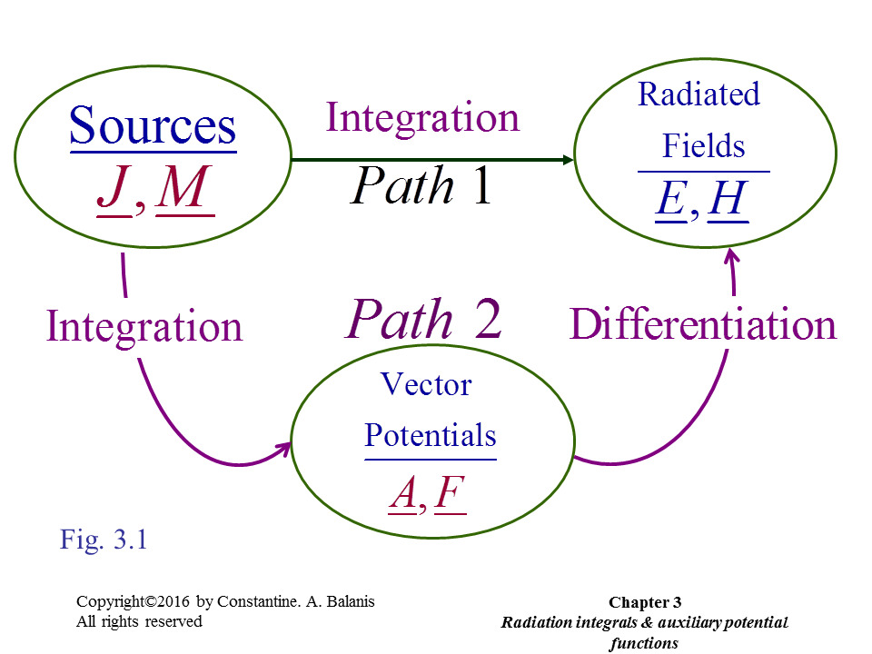

Slide 5
(6)

Slide 8
Solution of the Radiation Equation

Slide 11
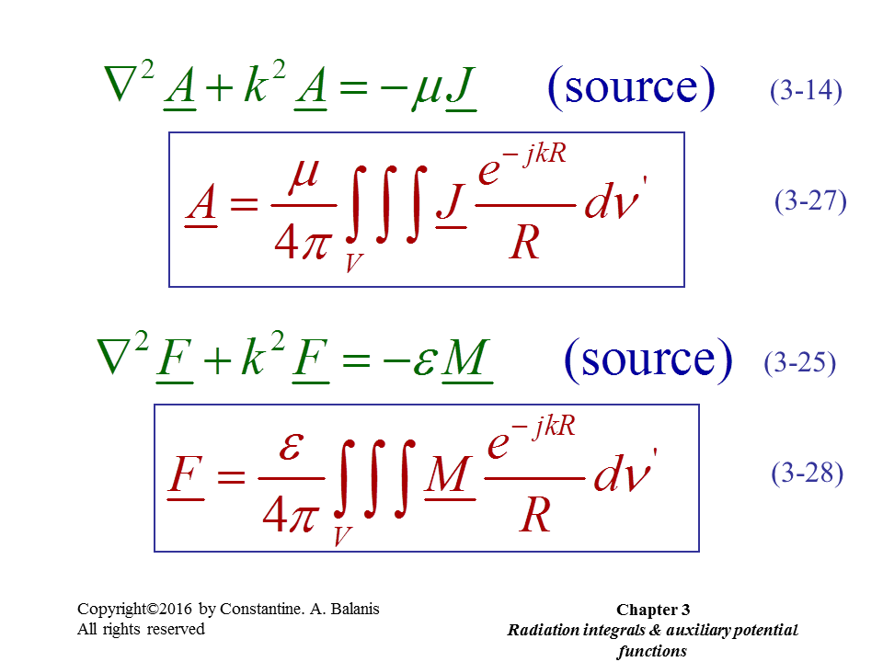

Slide 12
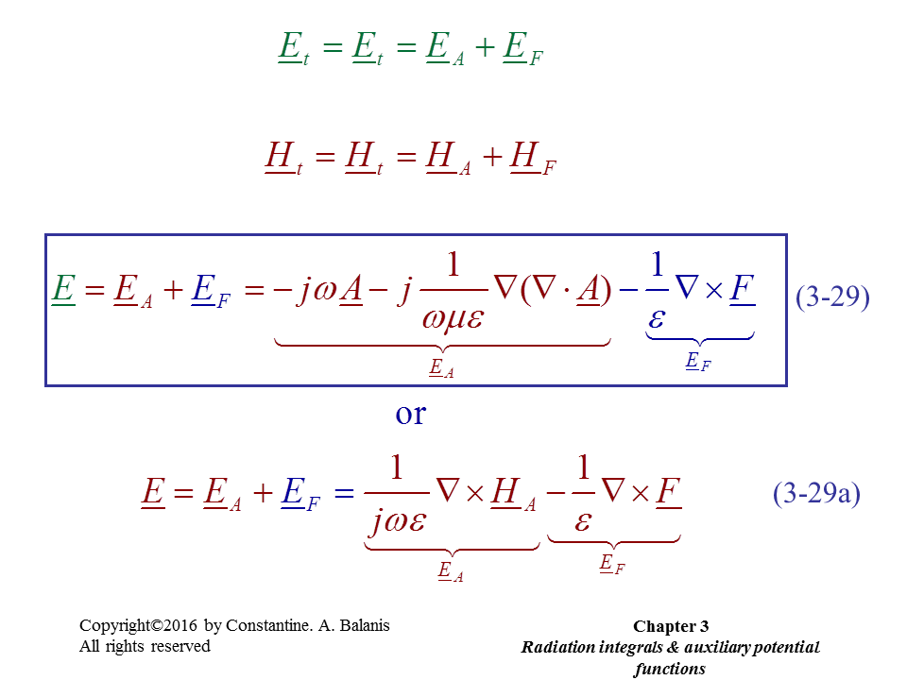

Slide 13
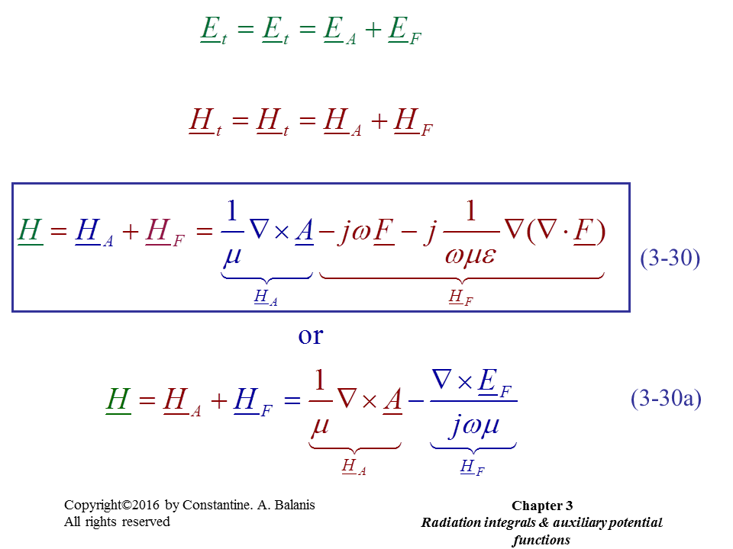

Slide 14
Simplified Solution at Far Field

Slide 15
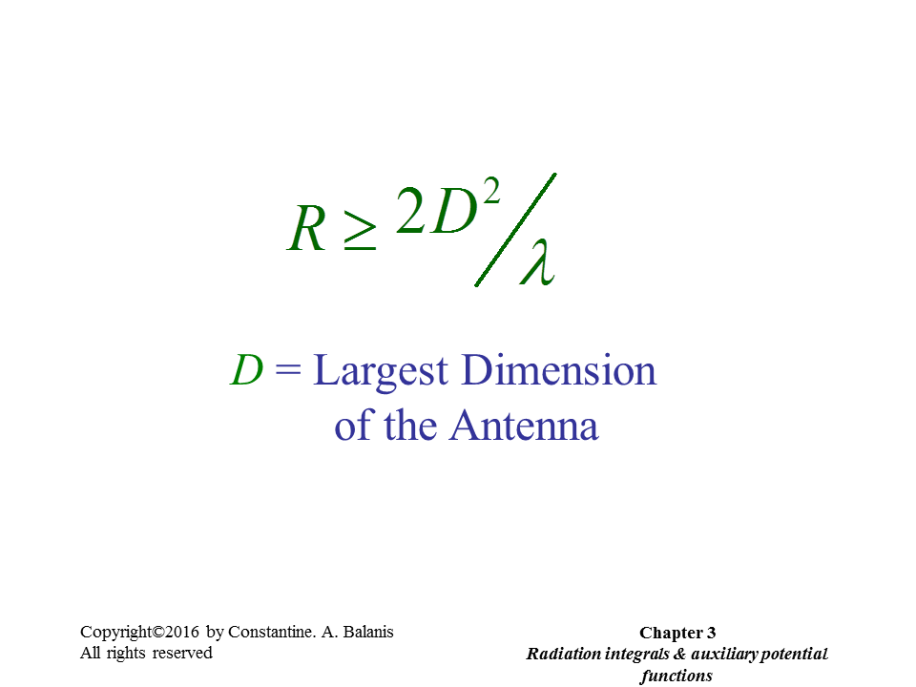

Slide 16
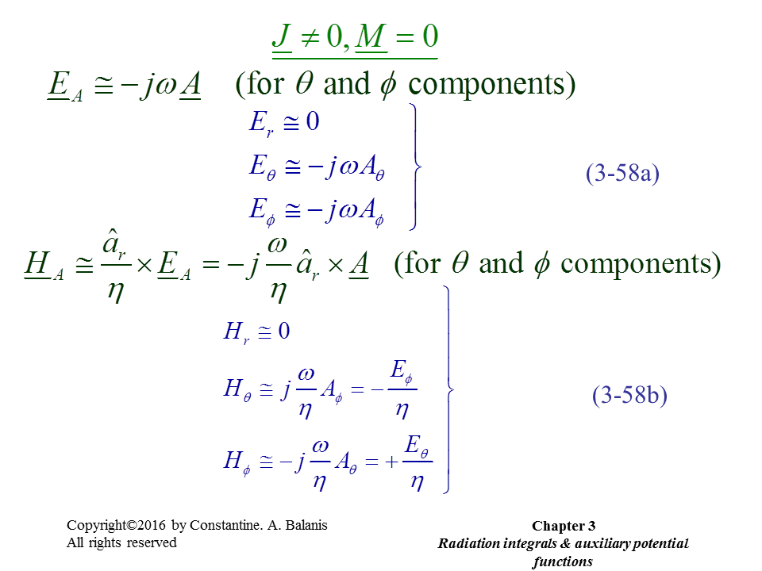

Slide 17
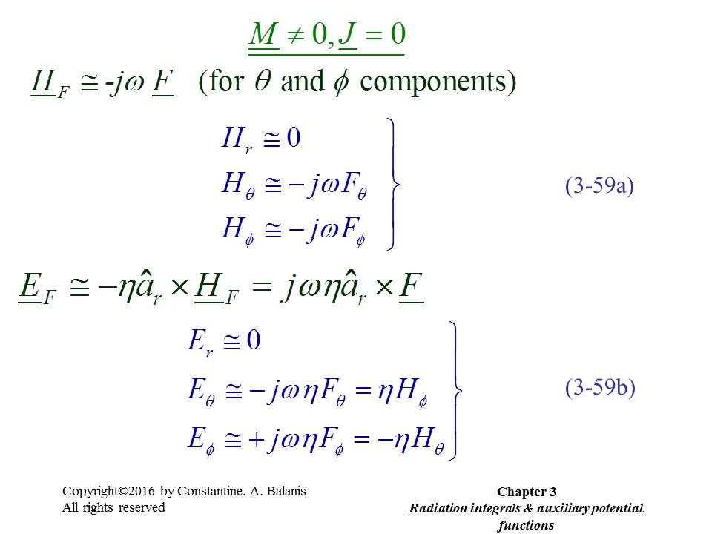
φ
θ

Slide 18
Radiated power

Slide 19
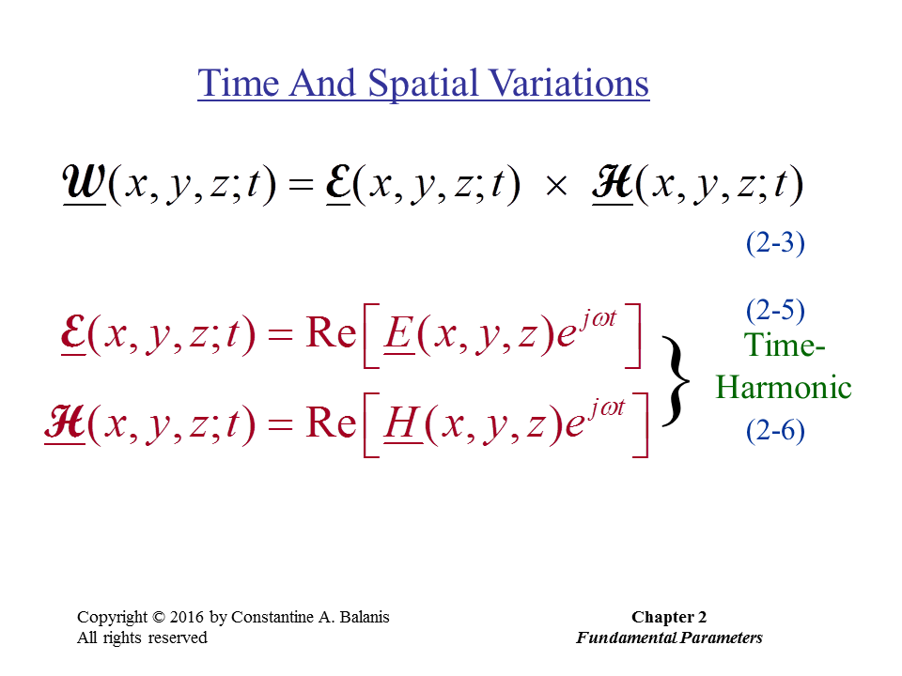

Slide 20
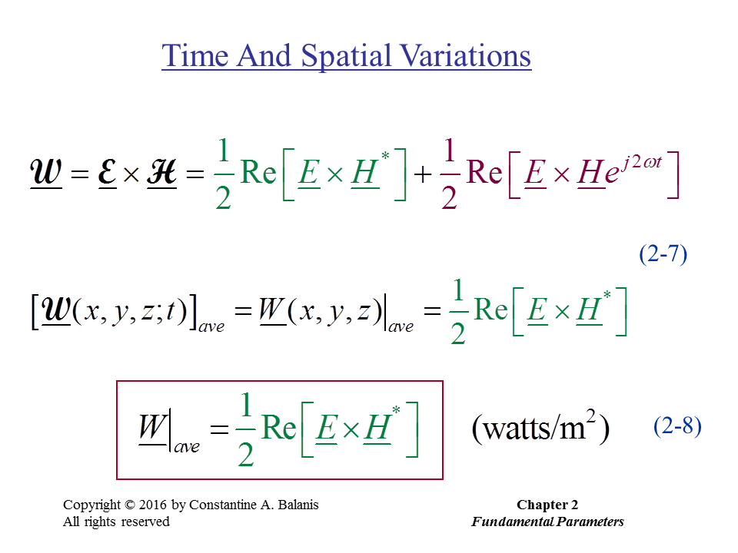

Slide 21
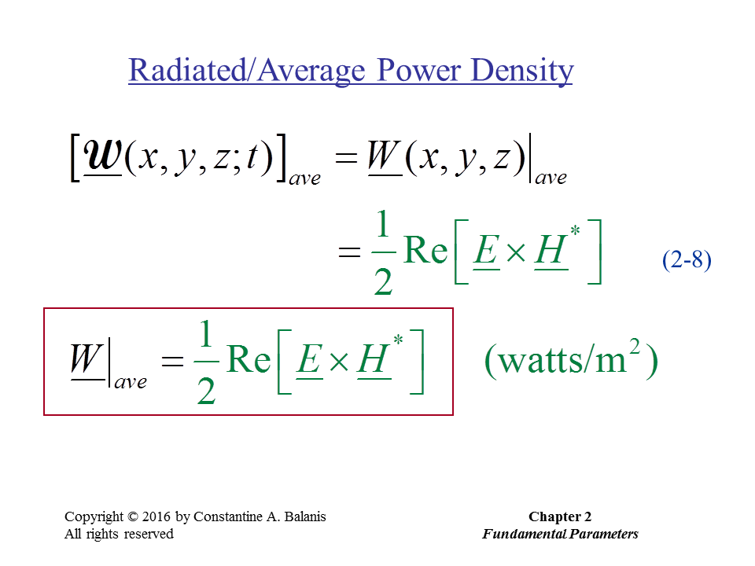

Slide 22
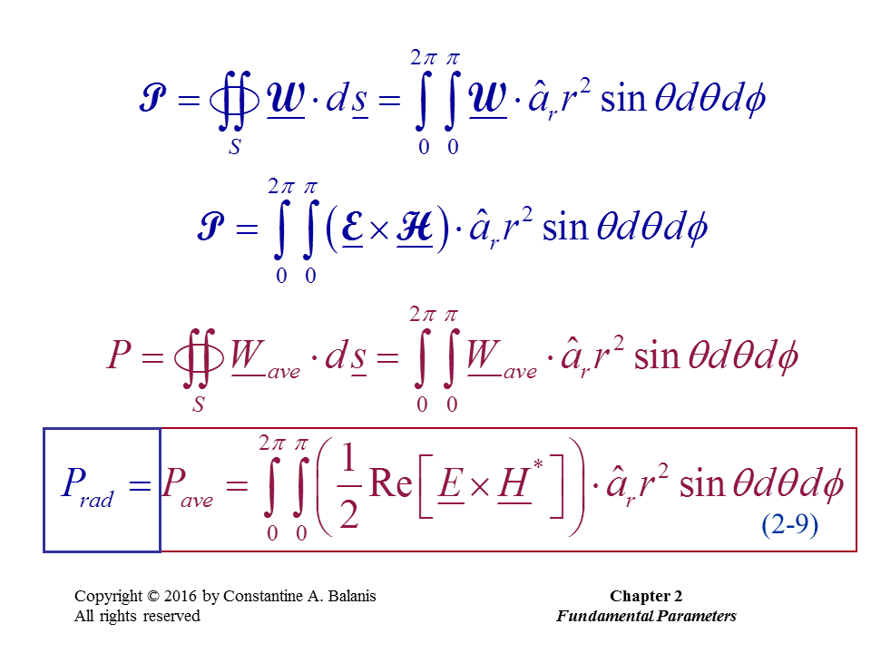

Slide 23
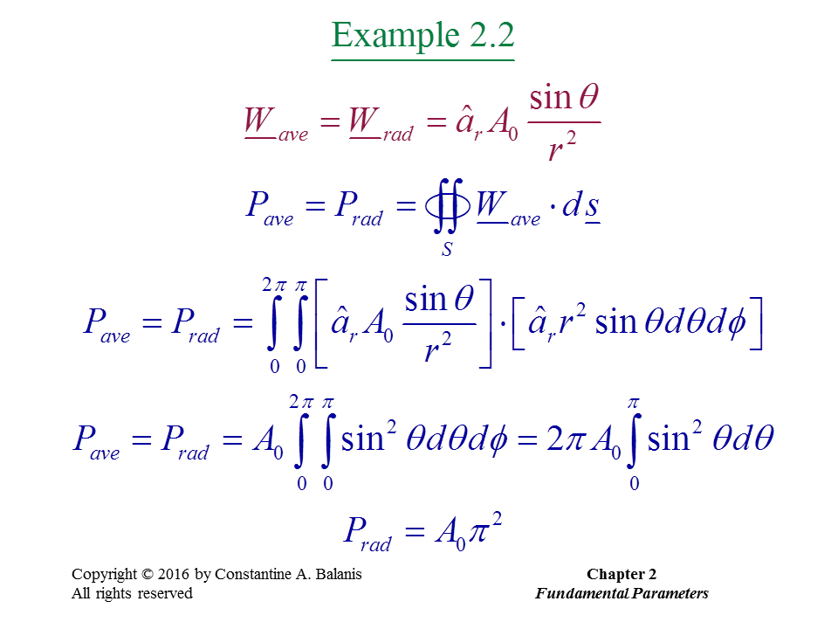

Slide 24
Reciprocity

